Slide 1

Next Gen Open Source Flexible
Engine Management

Slide 2
What is rusEFI?
Project started 2013
First hardware developed Q4 2013
4 current boards
~100,000 lines of C++
Around 20 active developers
~ 45 different engines running so far
Goals -
Flexible open source engine control

Slide 3
Features
C++ open source software featuring:
TunerStudio integration for online tuning
16x16 fuel, VE, timing tables
Spark control: distributor, wasted & sequential options
Fuel Injection: single, batch & sequential options
Closed loop idle control - solenoid or stepper
Basic CAN integration
Basic GPS integration
High speed data logging up to 150hz
Individual cylinder ignition trim
FSIO for special custom functions
Hardware features:
ARM 32 bit processor – STMF767 215mhz or STMF407 168mhz
Flexible hardware – Adaptable, Expandable, Reparable, and most conventional parts usable
Up to 12 cylinders

Slide 4
Upcoming features
Near future:
Knock sensing
Onboard wideband feedback
VVT
Front end for FSIO programing
Direct injection
MAF based fuelling
Fail safe ETB
Long term goals:
Simulink/Scilab integration for strategies
Modular hardware for development or research

Slide 5
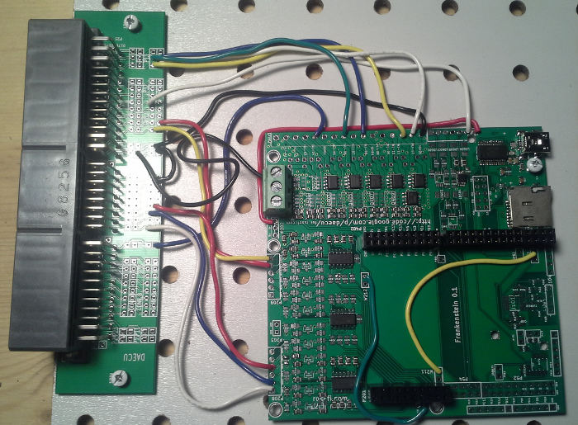
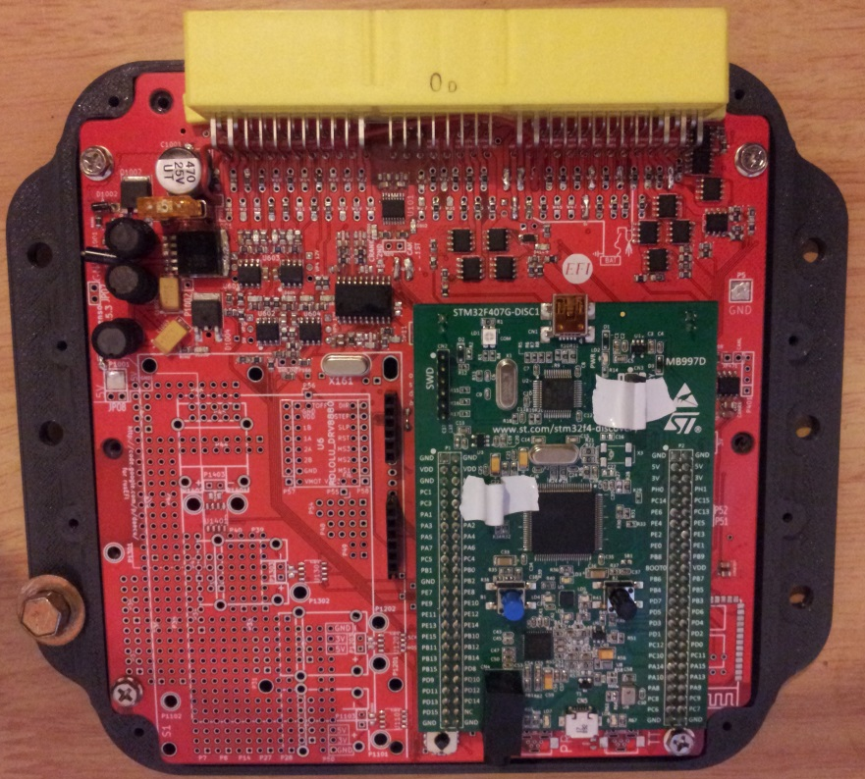
Early Boards
Frankenstein Released 2013 First Development board
Replaced by Frankenso
Frankenso Released ???? Current development board Designed as direct fit for Denso OEM applications
Still in use for development

Slide 6
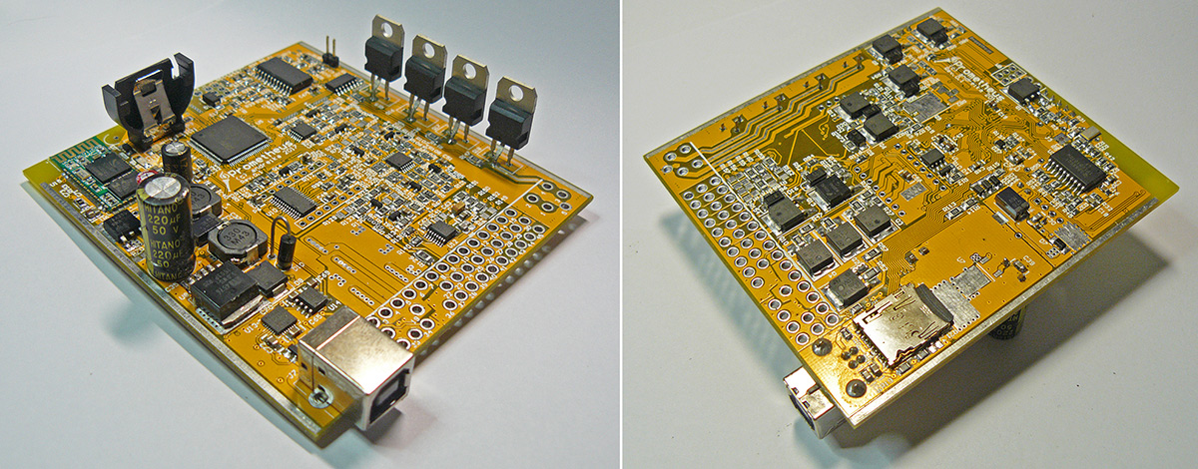
Current Boards
Prometheus – A drop in replacement for the SECU-3i
4 cylinder only

Slide 7
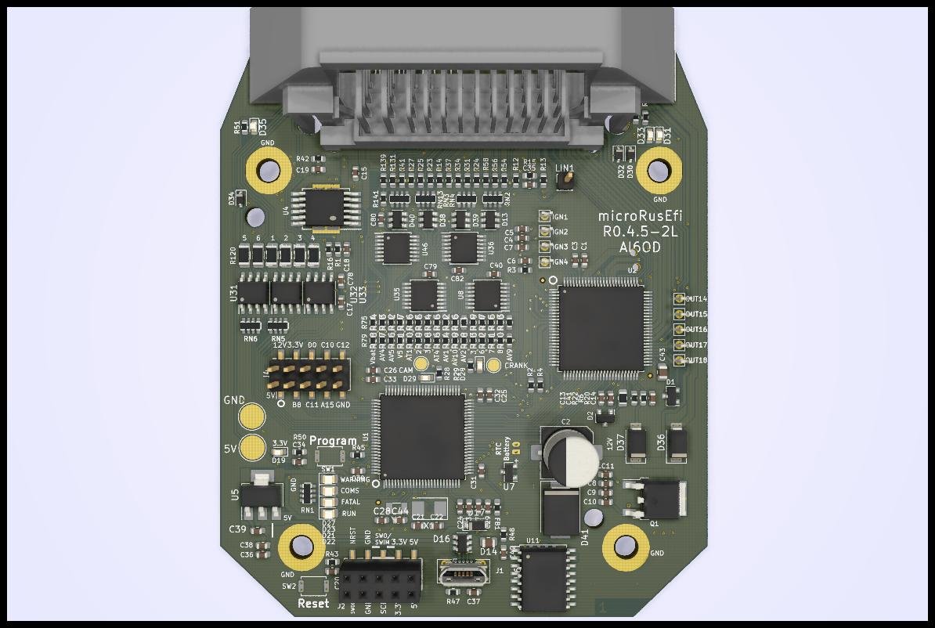
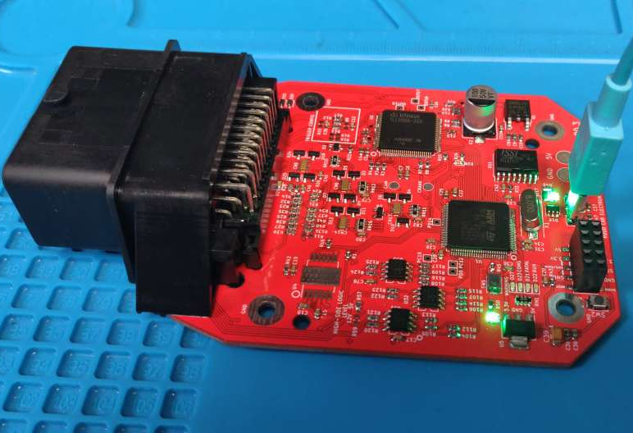
Current Boards
Micro rusEFI (MRE) – Miniature unit for space limited applications
Intended for 4 cylinder port injected engines
Can use all the software features of the full size units

Slide 8
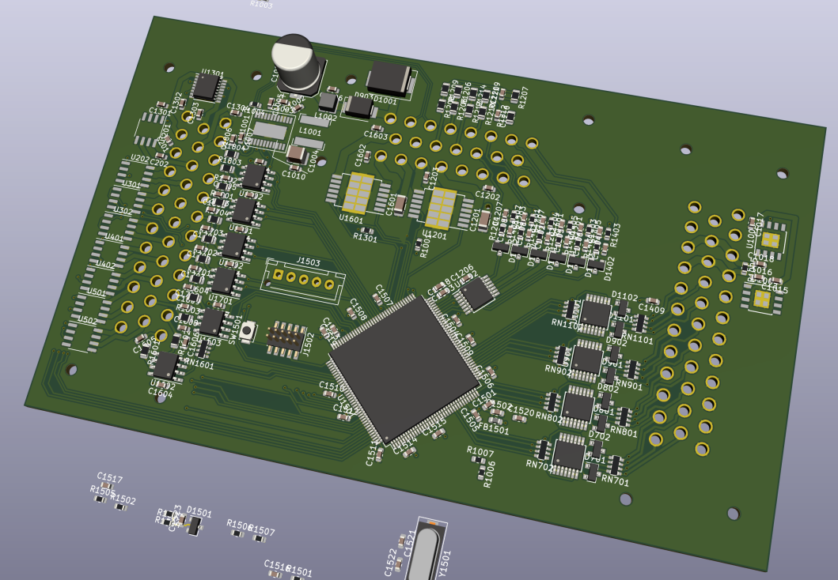
Current Boards
Proteus - A high-featured board for more complex engines (due late 2019)
16x 4A Low side drivers – injectors
12x 5v High/Low drivers - ignition
Dual ETB
4x 12v High side drivers – solenoids
10-pin internal header for knock expansion board

